Slide 1
Capstone 2 Project
Predicting Student Test Performance
Andrew Call

Slide 2
The Problem
Below Par Standardized Test Performance
Math Scores
59% of Students scored below 70
Reading & Writing
50% of Students scored below 70

Slide 3
The Opportunity
Can we predict how students will do based on individual characteristics?
Can we use this information to increase future scores?

Slide 4
Features
Free/Reduced Lunch Qualification
Test Preparation Course Completion
Parental Education Level
Ethnicity Group
Gender

Slide 5
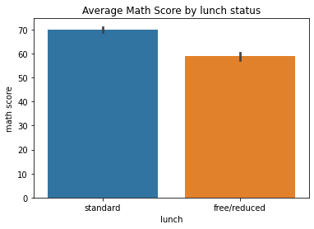
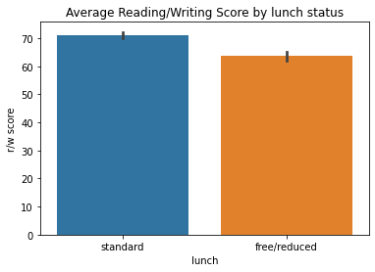
On Free/Reduced Lunch or Standard?

Slide 6
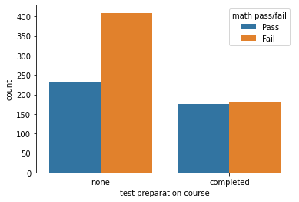
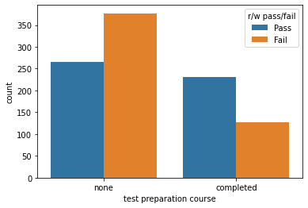
Test Prep Matters!

Slide 7
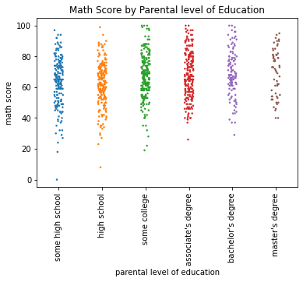

Parental Education Level

Slide 8
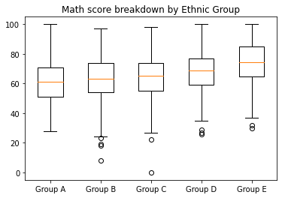
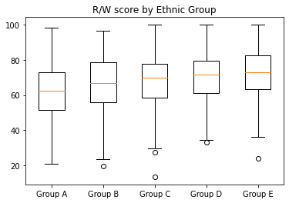
Ethnic Category Breakdown

Slide 9
What about Gender?
 | Math Avg. Score | Math Pass % | R/W Avg. Score | R/W Pass %
Females | 63.3 | 34.4% | 72.54 | 61.0%
Males | 68.73 | 47.9% | 64.39 | 37.3%

Slide 10
Modeling
Regression
Predict Scores
Classification
Predict Pass or Fail

Slide 11
Regression Models
 | Math R2 Score | Math MAE | R/W R2 Score | R/W MAE
OLS | 0.21 | 11.06 | 0.23 | 10.19
Linear | 0.19 | 11.16 | 0.23 | 10.29
Ridge | 0.19 | 11.16 | 0.23 | 10.29
Lasso | 0.13 | 11.50 | 0.18 | 10.70

Slide 12
Classification Models - MATH
 | F1 | Accuracy | Precision | Recall
SVM | 0.58 | 0.68 | 0.59 | 0.56
Logistic Regression | 0.57 | 0.68 | 0.60 | 0.55
Random Forest | 0.48 | 0.61 | 0.50 | 0.46
K-Neighbors | 0.47 | 0.59 | 0.47 | 0.46

Slide 13
Classification Models - R/W
 | F1 | Accuracy | Precision | Recall
SVM | 0.68 | 0.68 | 0.68 | 0.68
Logistic Regression | 0.68 | 0.69 | 0.70 | 0.66
Random Forest | 0.61 | 0.62 | 0.62 | 0.60
K-Neighbors | 0.59 | 0.59 | 0.59 | 0.59

Slide 14
Conclusions
Reading/Writing Scores are easier to Predict
Better Success with Classification Models
Models work best with ALL 5 features included
Free/Reduced Lunch on Math Scores
Test Prep Variable on Reading/Writing Scores

Slide 15
Recommendation #1
Increase # of Students taking the Test Preparation Course
Mandatory Completion
Incentives

Slide 16
Recommendation #2
Offer FREE at home and/or after school professional tutoring to ALL students that qualify for Free/Reduced Lunch.

Slide 17
Recommendation #3
Identify “At-Risk” students early
Monitor student progress
Provide extra supports
Peer to peer tutoring
Individualized instruction

Slide 18
THANK YOU!!!

